Slide 1
Extremely Large Scale Graph Embedding in Practice
——Algorithms, Theory, & Applications
Hongxia Yang
Senior Staff Data Scientist, DAMO Academy, Alibaba
yang.yhx@alibaba-inc.com

Slide 2
Cognitive
Graph
Graph Neural Networks
Motivations
15 mins
30 mins
30 mins
30 mins
30 mins
Network Embedding
Practical
Applications

Slide 3
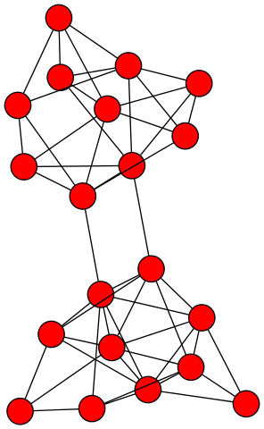
Network (Graph)
The general description of data and their relations
Notes:
左，右图更新
challenge

Slide 4
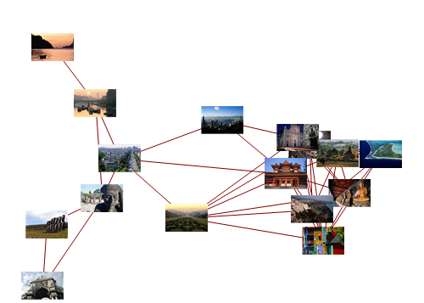
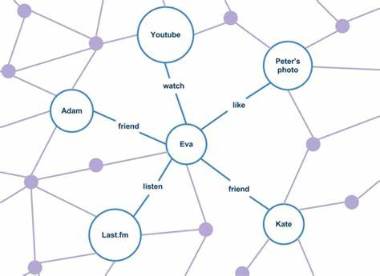
Why network is important?
Can you name a case where only care about an object but not its relations with other subjects?
Image Characterization
Social Capital
Target
Target
Reflected by relational subjects
Decided by relational subjects
Notes:
左，右图更新
challenge

Slide 5
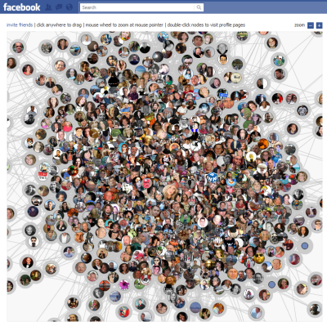
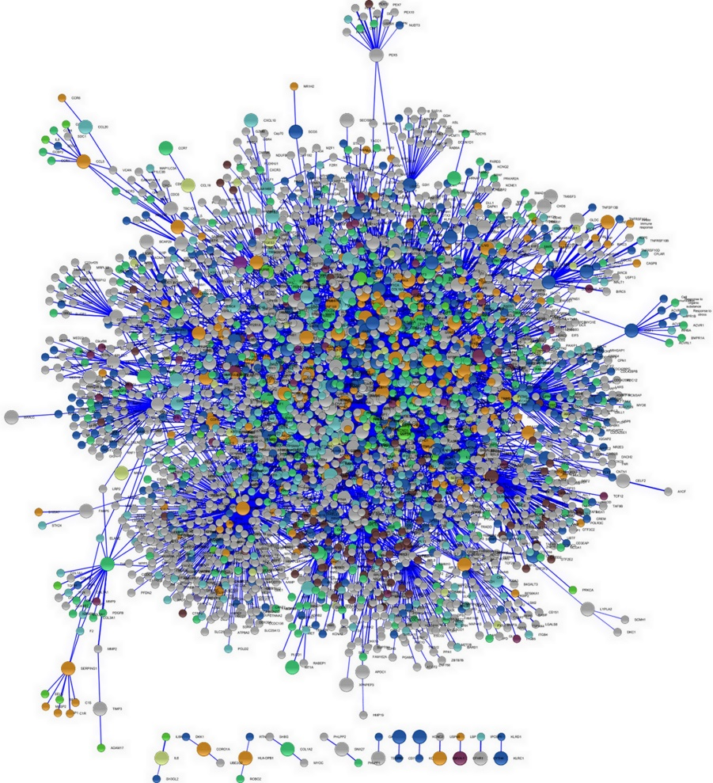
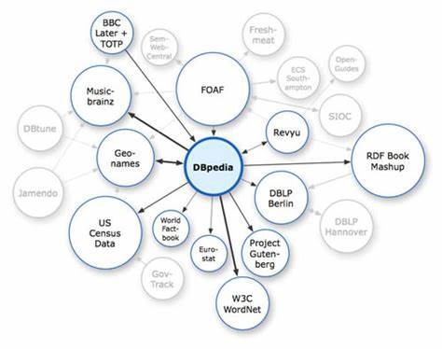

Graph/network data is everywhere
Social Networks
Biology Networks
Finance Networks
Internet of Things
Information Networks
Logistic Networks
Notes:
左，右图更新
challenge

Slide 6
Graph as a data model
The last resort for the curse of complexity in real applications
Geographical networks, relationships, …
Divide-and-conquer in modeling
Individual nodes and edges are well structured
Global structures are weakly organized

Slide 7
Mining graphs and networks
Multiple possible views
Micro view: nodes and edges
Macro view: global structures and properties
Temporal view: changes over time
Many important tasks
Patterns, classification, prediction, clustering, outlier detection, …

Slide 8
Why is graph and network mining challenging?
Key assumptions in efficient data processing
Well structured data
Synchronized
Challenges in graph and network data
Some basic structures, but many unstructured elements
Asynchronous

Slide 9
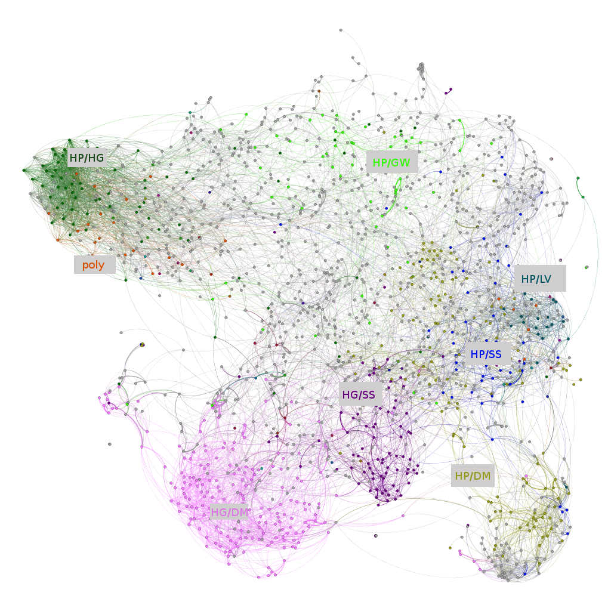
Research problems on networks
Descriptive and Predictive
Node importance
Community detection
Network distance
Link prediction
Node classification
Network evolution
…

Slide 10
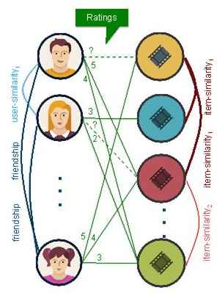

Many applications are intrinsically network problems
Link prediction in bipartite graphs
Recommendation Systems

Slide 11
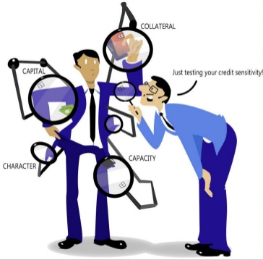
Many applications are intrinsically network problems
Financial credit & risk management
Node importance & classification

Slide 12
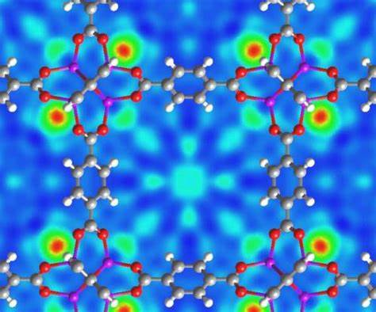
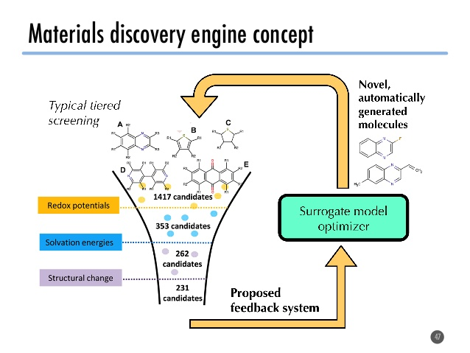
Many applications are intrinsically network problems
New material discovery
Subgraph pattern discovery

Slide 13
Traditional methods – graph theory
Real networks
Centrality Problem
Graph
Theory
Isomorphism Problem
Routing Problem
…
Billion nodes
Challenge 1: Problem Scale

Slide 14
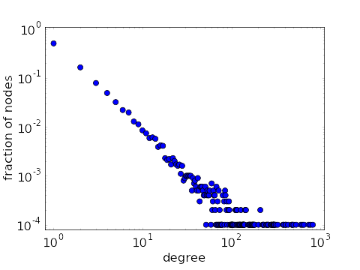
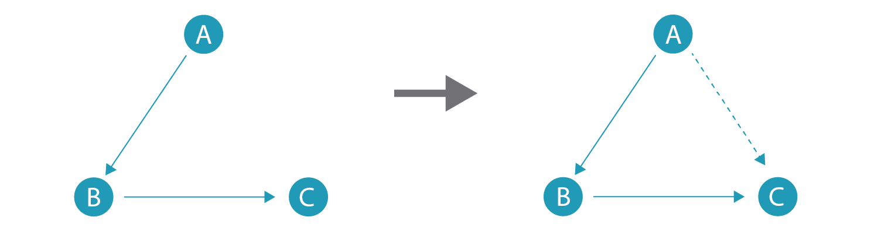
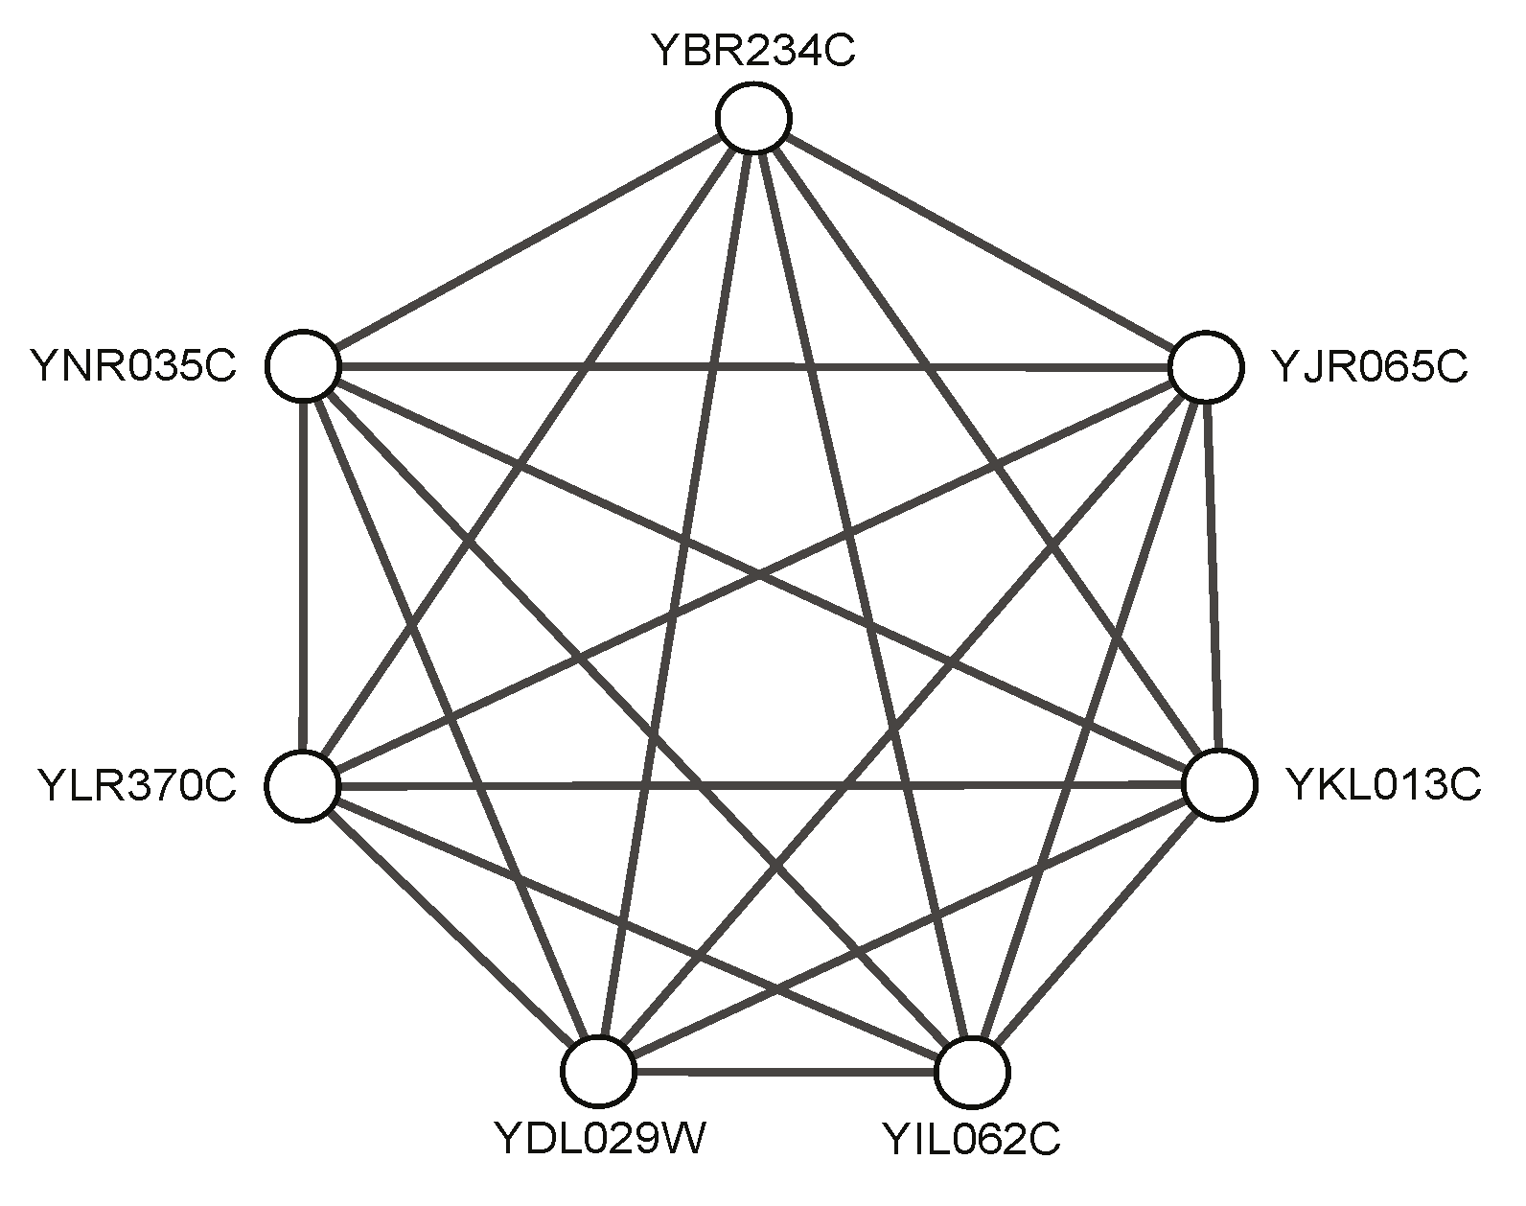
Traditional methods – graph analysis
Real Networks
Graph Patterns
Applications
Power-law
Link prediction
Graph
Analysis
Community detection
Triadic Closure
Anomaly detection
Clustering effect
…
High Complexity
High Diversity
Challenge 2: Complexity and Diversity

Slide 15

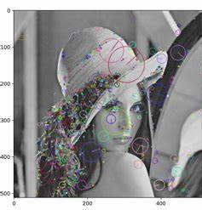
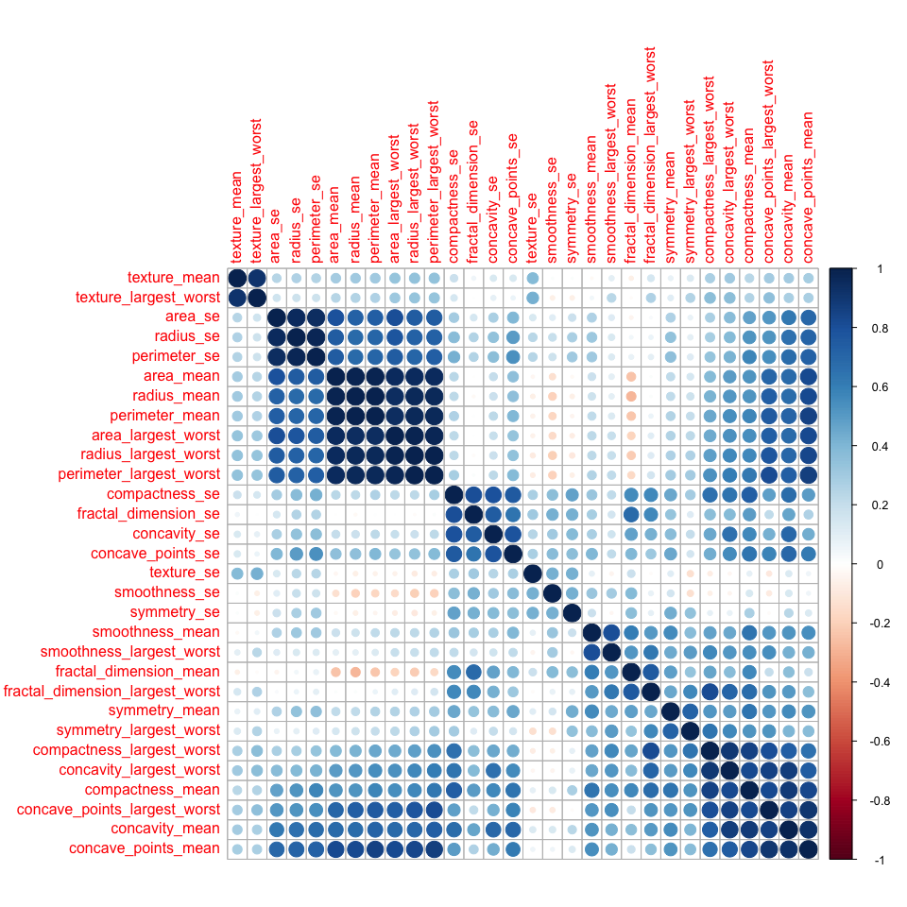
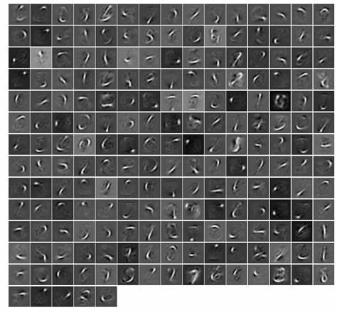
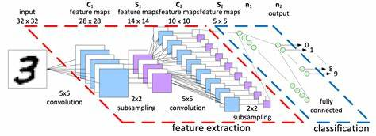
From graph theory and analysis to learning
Progressive development of learning related fields
Raw Data
Feature Crafting
Feature Selection
Representation Learning
End-to-end Learning
Go through a similar development path?

Slide 16
Learning from Networks
Provide general learning solutions to various tasks over a diverse range of complex networks.
Raw Data
Feature Crafting
Feature Selection
Representation Learning
End-to-end Learning
Graph Theory and Analysis
Graph Feature Selection
Network Embedding
Graph Neural Network

Slide 17
GE Family
Graph Embedding
Shallow Embedding Methods
Deep Embedding Methods
Difficult to deal with large scale graphs
The input dimension to the autoencoder is fixed at |V|
Cannot cope with unseen nodes
The structure and size of the autoencoder is fixed
Matrix Factorization Based Methods
Graph Autoencoder
[Belkin et al. NIPS2002]
[Ahmed et al. WWW2013]
[Cao et al. KDD2015]
[Ou et al. KDD2016]
[Cao et al. AAAI2016]
[Wang et al. KDD2016]
Graph Convolutional Network
[Bruna et al., ICLR2014]
[Duvenaud et al., NIPS2015]
[Kipf&Welling, ICLR2017]
Random Walk Based Methods
[Perozzi et al. KDD2014]
[Grover et al. KDD2016]
Graph-Gated Recurrent Unit
No parameters sharing
Simply an embedding lookup based on arbitrary node id
Fail to leverage node attributes
E.g., user profiles on a recommendation task
Transductive model
The cold start problem
[Li et al. ICLR2018]
[Yan et al. AAAI’2018]
[Wu et al. IJCAI’2019]
[Guo et al. AAAI2019]

Slide 18
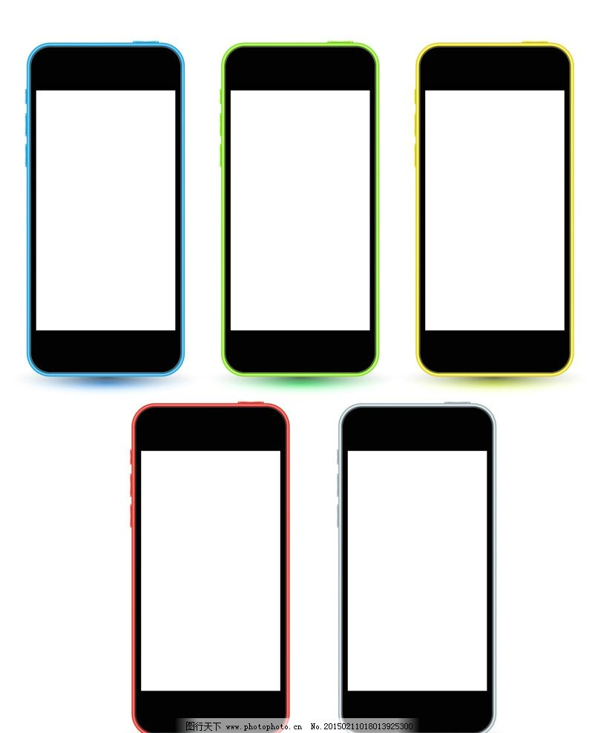


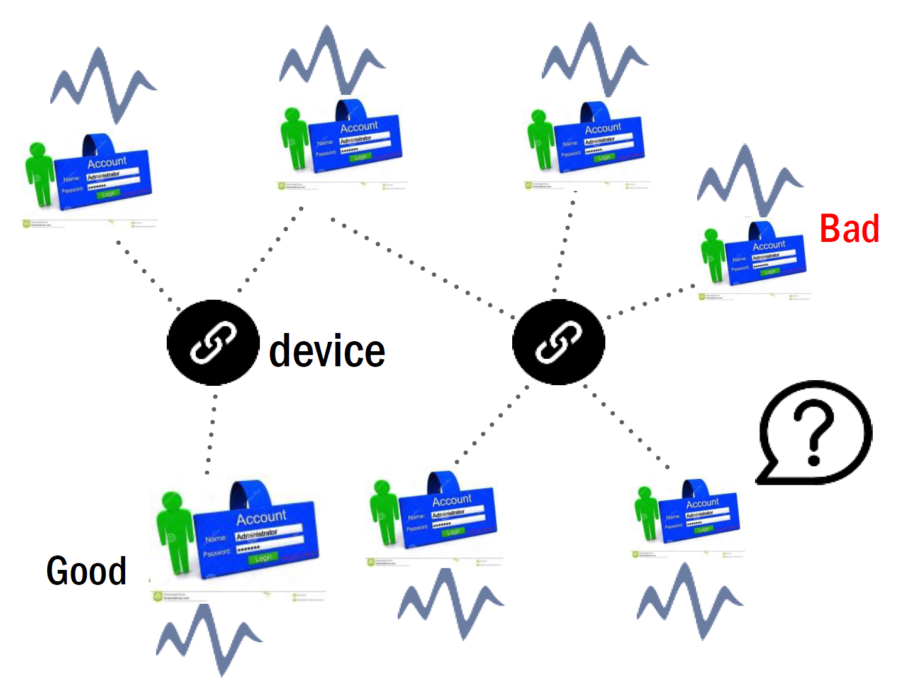
Real world applications
Heterogeneous knowledge graphs
Online recommendation
Online to offline recommendation
Anomaly detection in FinTech

Slide 19
Cognitive
Graph
Motivations
Graph Neural Networks
15 mins
30 mins
AM
30 mins
30 mins
30 mins
30 mins
Network Embedding
Practical Applications

Slide 20
Revisit network representation
G = ( V, E )
G = ( V )
Vector Space
generate
embed
Easy to parallel
Can apply classical ML methods

Slide 21
The ultimate goal
Network Inference
Node importance
Community detection
Network distance
Link prediction
Node classification
Network evolution
…
in Vector Space

Slide 22

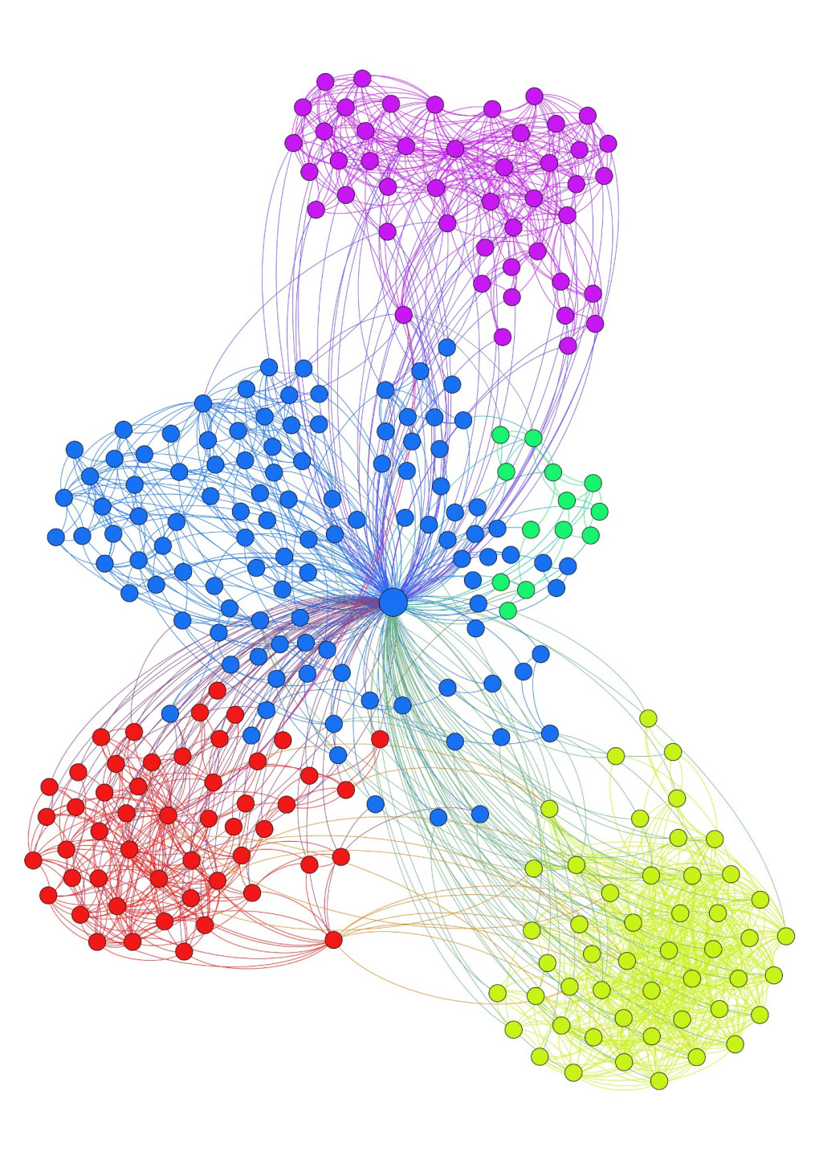
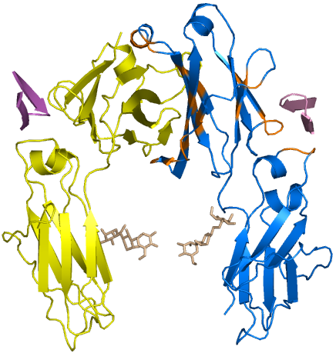

The information encoded in networks
Topological
Information
Semantic
Information
Nodes Attributes
Topology Vectorization is the key problem.

Slide 23
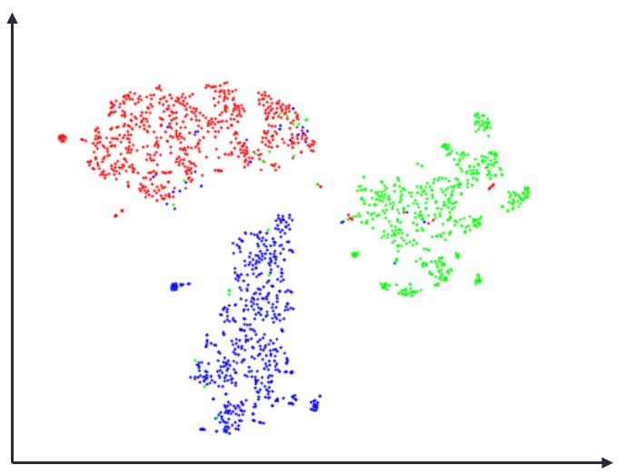
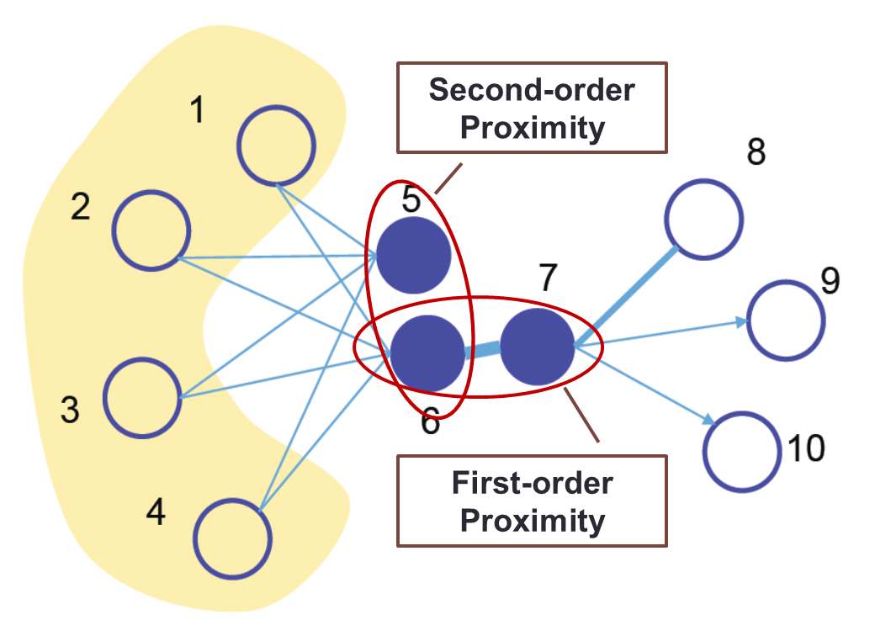
Network Embedding
Goal Support network inference in vector space
Reflect network structure
Maintain network properties
B
A
C
Transitivity
Notes:
分2页，1.0和2.0的区别

Slide 24
Outline
Structure-preserved network embedding
Property-preserved network embedding
Dynamic network embedding
Robustness, Explainability and Applicability
Notes:
分2页，1.0和2.0的区别

Slide 25
Network Structures
Nodes & Links
Pair-wise Proximity
Community Structures
Hyper Edges
Global Structure

Slide 26
Nodes & Links
Reconstruct the original network
Matrix Factorization
Adjacency Matrix
Embedding Matrix
Reconstruct all the links? May cause overfitting.
The network inference ability is seriously limited.
Notes:
Actually, network embedding is not a new topic. But most of the previous works focus on the first goal, to find an embedding space to reconstruct the original network. For example, matrix factorization is a typical network embedding method. The network is represented by adjacency matrix. After decomposing the adjacency matrix through SVD, we can get the embedding matrix. From the objective function, we can see that the aim of the embedding is to optimally reconstruct all the observed links. That means, we want to find a embedding space to overfit the network. In such an embedding space, the network inference ability is seriously limited.

Slide 27
Network Structures
Nodes & Links
Pair-wise Proximity
Community Structures
Hyper Edges
Global Structure

Slide 28
High-Order Proximity
Capturing the underlying structure of networks
Advantages:
Solve the sparsity problem of network connections
Measure indirect relationship between nodes
Notes:
数学：传递性；社会学：三角闭合

Slide 29
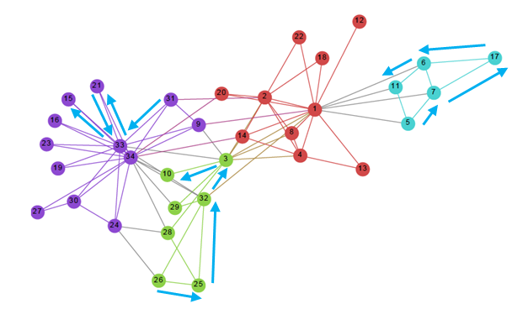
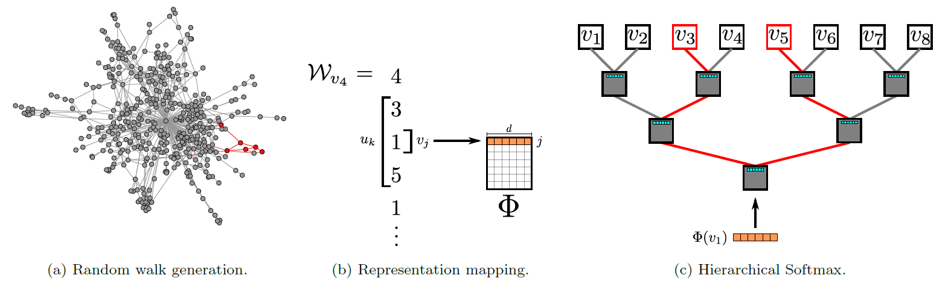
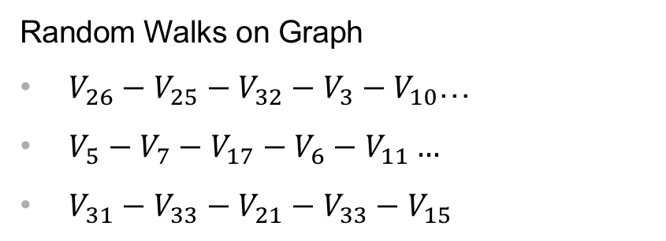
Deepwalk
Exploit truncated random walk to define neighborhood of a node.
Random Walks on Graph
$V_{26}−V_{25}−V_{32}−V_{3}−V_{10}$…
$V_{5}−V_{7}−V_{17}−V_{6}−V_{11}…$
$V_{31}−V_{33}−V_{21}−V_{33}−V_{15}$
B. Perozzi et al. Deepwalk: Online learning of social representations. KDD 2014.

Slide 30
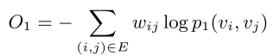
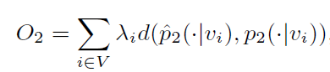
LINE
LINE with First-order Proximity:
local pairwise
LINE with Second-order Proximity:
neighborhood structures
Jian Tang et al. LINE: Large-scale Information Network Embedding. WWW 2015.

Slide 31
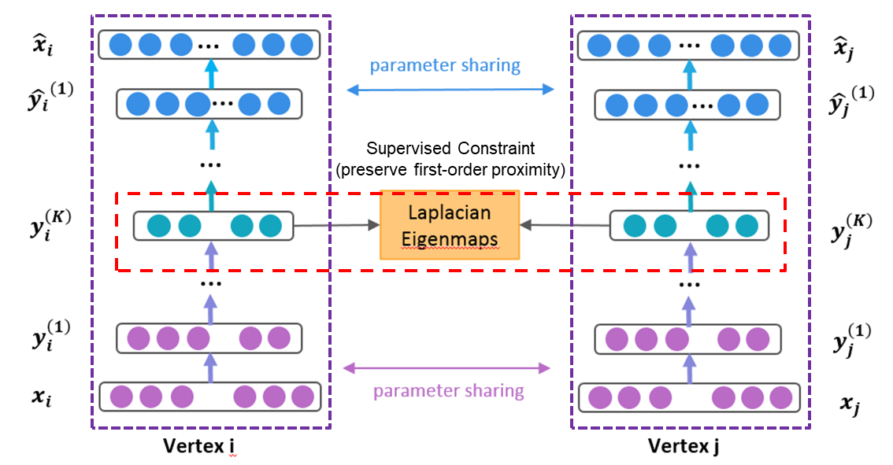
SDNE – Structural Deep Network Embedding
Unsupervised Autoencoder
(preserve second-order proximity)
Unsupervised Autoencoder
(preserve second-order proximity)
Daixin Wang et al. Structural Deep Network Embedding. KDD, 2016.

Slide 32
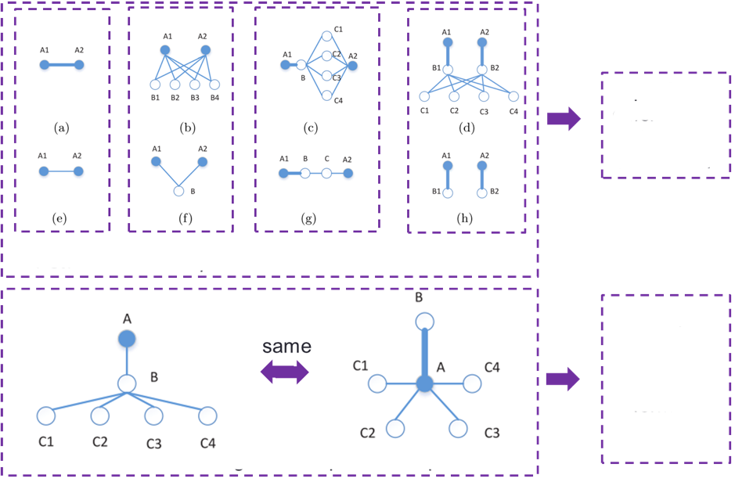
GraRep
capturing
different
k-step
information
1-step 2-step 3-step 4-step
maintaining
different
k-step
information
separately
Do not distinguish 1-step and 2-step
Shaosheng Cao et al. GraRep: Learning Graph Representations with Global Structural Information. CIKM 2015.

Slide 33
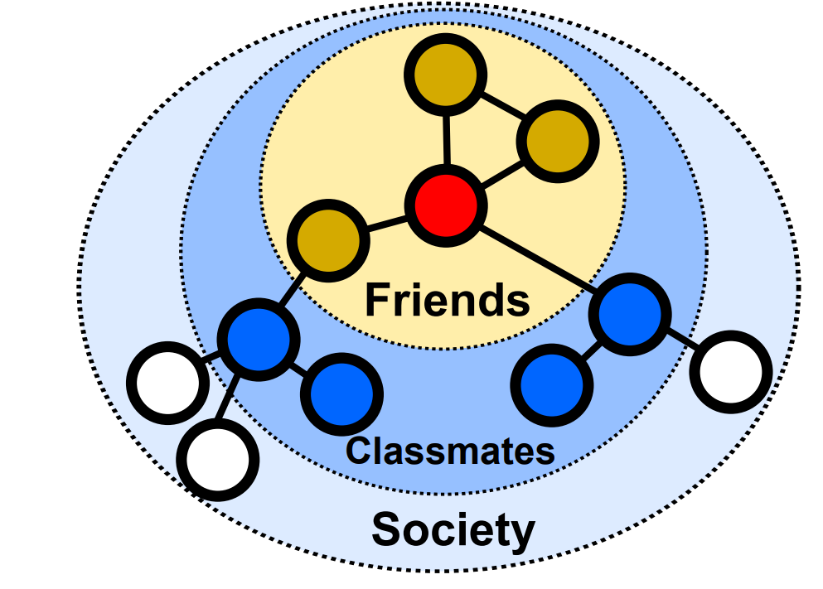
What is the right order?
Different networks/tasks require different high-order proximities
E.g., multi-scale classification (Bryan Perozzi, et al, 2017)
E.g., networks with different scales and sparsity
Proximities of different orders can also be arbitrarily weighted
E.g., equal weights, exponentially decayed weights (Katz)

Slide 34
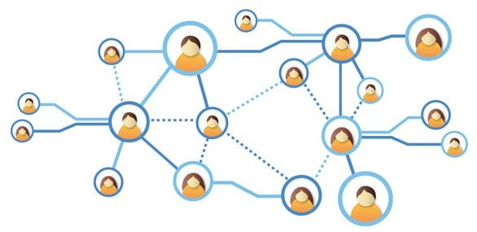


What is the right order?
Existing methods can only preserve one fixed high-order proximity
Different high-order proximities are calculated separately
-> How to preserve arbitrary-order proximity while guaranteeing accuracy and efficiency?
Proximity1
……
Proximity2
Proximity3
Proximity4
Time consuming!
Embedding1
Embedding2
Embedding3
Embedding4

Slide 35
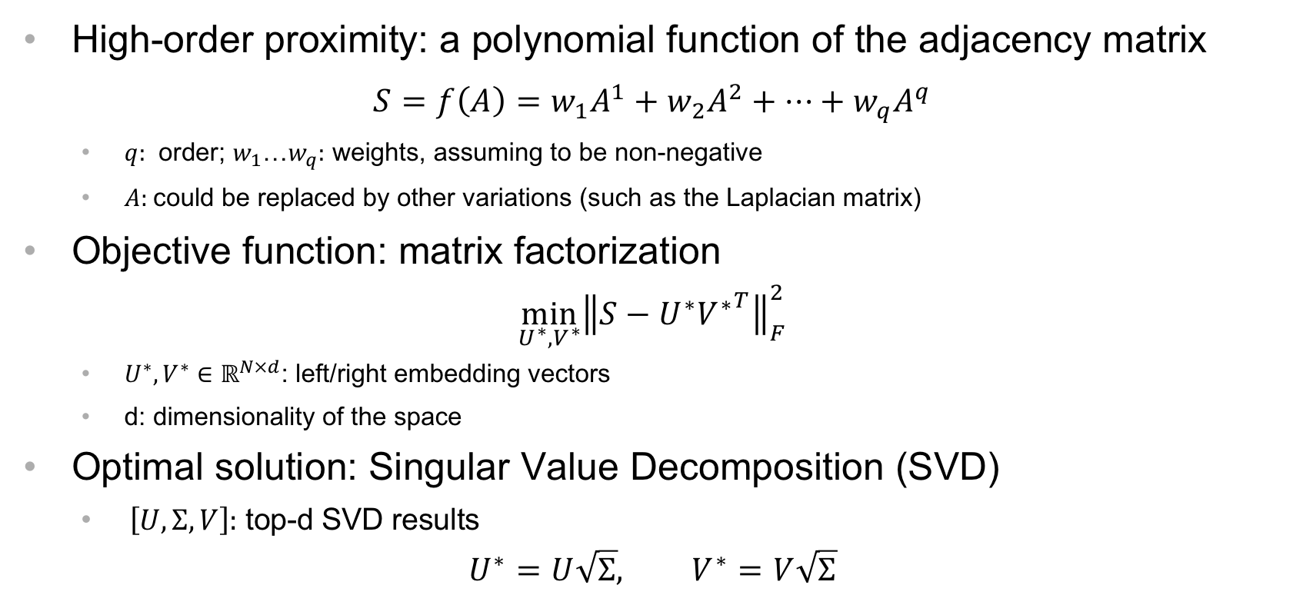
Problem Formulation
High-order proximity: a polynomial function of the adjacency matrix
$$S=f\left(A\right)=w_{1}A^{1}+w_{2}A^{2}+…+w_{q}A^{q}$$
$q:$ order; $w_{1}$…$w_{q}:$ weights, assuming to be non-negative
$A:$could be replaced by other variations (such as the Laplacian matrix)
Objective function: matrix factorization
$$\min_{U^{∗},V^{∗}}{{\left\|S−U^{∗}{V^{∗}}^{T}\right\|}_{F}^{2}}$$
$U^{∗},V^{∗}∈ℝ^{N×d}$: left/right embedding vectors
d: dimensionality of the space
Optimal solution: Singular Value Decomposition (SVD)
$\left[U,Σ,V\right]:$ top-d SVD results
$$U^{∗}=U\sqrt{Σ}, V^{∗}=V\sqrt{Σ}$$
Z. Zhang, et al. Arbitrary-Order Proximity Preserved Network Embedding. KDD, 2018.
Notes:
Taylor expansion

Slide 36
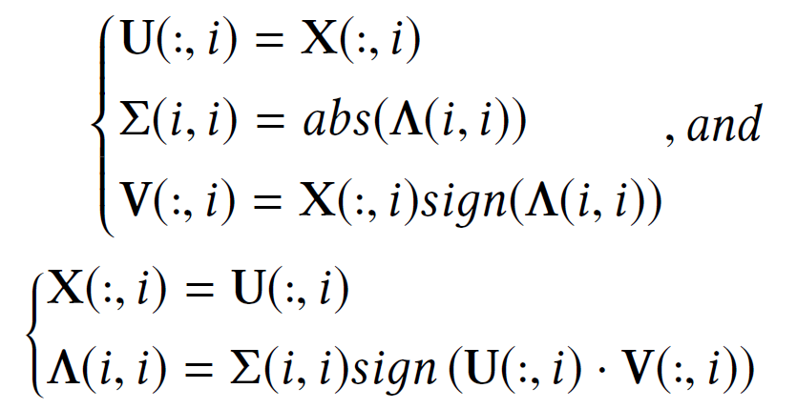
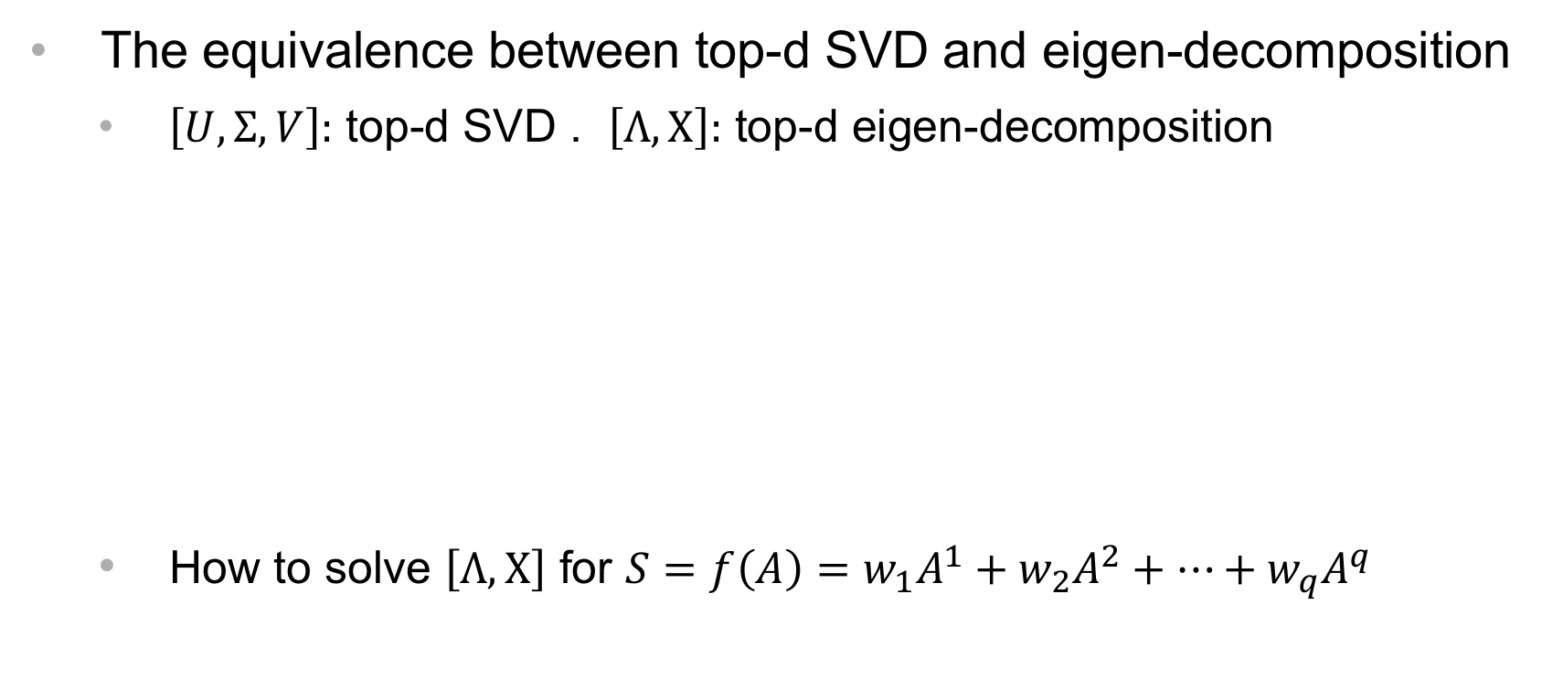
Problem Transformation
The equivalence between top-d SVD and eigen-decomposition
$\left[U,Σ,V\right]:$ top-d SVD . $\left[Λ,X\right]:$ top-d eigen-decomposition
How to solve $\left[Λ,X\right]$ for $S=f\left(A\right)=w_{1}A^{1}+w_{2}A^{2}+…+w_{q}A^{q}$
Z. Zhang, et al. Arbitrary-Order Proximity Preserved Network Embedding. KDD, 2018.
Z. Zhang, et al. Arbitrary-Order Proximity Preserved Network Embedding. KDD, 2018.

Slide 37
Network Structures
Nodes & Links
Pair-wise Proximity
Community Structures
Hyper Edges
Global Structure

Slide 38
Motivation
Vertexes in different parts of the network may have similar roles(global position)
Example：
Managers in the social network of a company
Outliers in a network in the task of anomaly detection
Social network with different position
How to reflect the role or importance of a vertex in embedding space?

Slide 39
Existing embedding methods
3
5
1
7
8
2
4
6
They can only preserve local proximity(Structural equivalence), can not reflect the global position
Embeddings of node 5,6 in left network will be similar but embeddings of node 1, 2 in right network will not be similar.

Slide 40
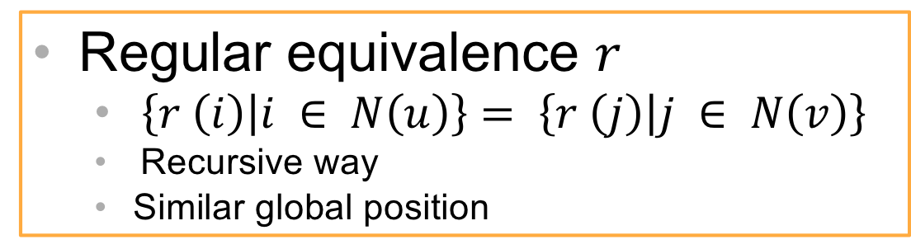
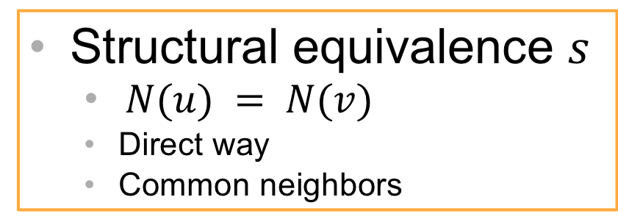
Regular Equivalence
Two nodes are regularly equivalent if their network neighbors are themselves similar (i.e. regularly equivalent).
3
4
1
5
3
1
7
5
8
2
2
4
6
6
Structural equivalence $s$
$N(u) = N(v)$
Direct way
Common neighbors
Regular equivalence $r$
$\left\{r \left(i\right) | i ∈ N\left(u\right)\right\}= \left\{r \left(j\right) | j ∈ N\left(v\right)\right\}$
Recursive way
Similar global position
Regular equivalence is largely ignored in network embedding

Slide 41
Naïve Solutions
Basis: two regularly equivalent nodes should have similar embeddings
1. Explicitly calculate the regular equivalence of all vertex pairs
infeasible for large-scale networks due to the high complexity of calculating regular equivalence
2. Replace regular equivalence into simpler graph theoretic metrics
centrality measures
one centrality can only capture a specific aspect of network role
some centrality measures also bear high computational complexity
Ke Tu, et al. Deep Recursive Network Embedding with Regular Equivalence. KDD, 2018.

Slide 42
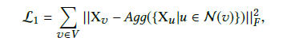
Deep Recursive Network Embedding
The definition of regular equivalence is recursive
Aggregating neighbors’ information in a recursive way
How to design the aggregating function
Variable length of neighbors
Highly nonlinear
→ Layer-normalized LSTM
Ke Tu, et al. Deep Recursive Network Embedding with Regular Equivalence. KDD, 2018.

Slide 43






Deep Recursive Network Embedding
reconstruct
6
7
$$X_{0}$$
$$h_{T}$$
0
3
1
2
5
1
LN
LN
LN
3
9
8
MLP
0
LSTM
LSTM
LSTM
$$d_{0}$$
2
4
1
7
4
3
2
8
5
6
$$X_{3}$$
$$X_{1}$$
$$X_{2}$$
8
9
3
1
2
(a)
(b)
(c)
(d)
(a) Sampling neighborhoods
(b) Sorting neighborhoods by their degree
(c) Aggregate neighbors
(d) A Weakly guided regularizer
Ke Tu, et al. Deep Recursive Network Embedding with Regular Equivalence. KDD, 2018.

Slide 44
Section Summary
Nodes & Links
Node Neighborhood
Network Characteristics
Pair-wise Proximity
Community Structures
Application Characteristics
Hyper Edges
Global Structure

Slide 45
Outline
Structure-preserved network embedding
Property-preserved network embedding
Dynamic network embedding
Robustness, Explainability and Applicability
Notes:
分2页，1.0和2.0的区别

Slide 46
Why preserve network properties?
Heterogeneity
Notes:
Next, let’s come to the second problem, maintain network properties, especially, transitivity.
In networks, transitivity is ubiquitous. If A and B have a link, B and C have a link, then it’s possible that A and C also have a link.
At the same time, the transitivity phenomenon also exists in the embedding space, that is guaranteed by the triangle inequality. If A is close to b, and B is close to C, then A will be relatively close to C.
It seems that these two sides perfectly match. However, real network data is complex than we assumed.

Slide 47
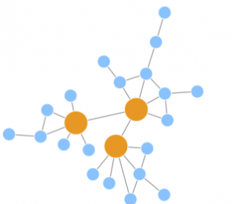
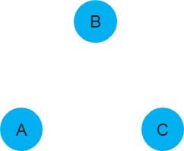
Two important network properties
Transitivity
Uncertainty
Notes:
Next, let’s come to the second problem, maintain network properties, especially, transitivity.
In networks, transitivity is ubiquitous. If A and B have a link, B and C have a link, then it’s possible that A and C also have a link.
At the same time, the transitivity phenomenon also exists in the embedding space, that is guaranteed by the triangle inequality. If A is close to b, and B is close to C, then A will be relatively close to C.
It seems that these two sides perfectly match. However, real network data is complex than we assumed.

Slide 48
Outline
Structure-preserved network embedding
Property-preserved network embedding
Dynamic network embedding
Robustness, Explainability and Applicability
Notes:
分2页，1.0和2.0的区别

Slide 49
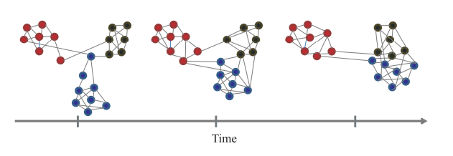
Dynamic Networks
Networks are dynamic in nature
New (old) nodes are added (deleted)
New users, products, etc.
The edges between nodes evolve over time
Users add or delete friends in social networks, or neurons establish new connections in brain networks.
How to efficiently incorporate the dynamic changes when networks evolve?

Slide 50
Key problems in dynamic network embedding
I : Out-of-sample nodes
II : Incremental edges
III: Aggregated error
IV: Scalable optimization

Slide 51
Challenge: High-order Proximity
High-order proximity
Critical structural property of networks
Measure indirect relationship between nodes
Capture the structure of networks with different scales and sparsity
Network Embedding V.S. Traditional Graph Embedding

Slide 52
Challenge: High-order Proximity
I : Out-of-sample nodes
II : Incremental edges
III: Aggregated error
IV: Scalable optimization
Preserve High-order Proximities
Local Change leads to Global Updating

Slide 53
Key problems in dynamic network embedding
I : Out-of-sample nodes
II : Incremental edges
III: Aggregated error
IV: Scalable optimization

Slide 54
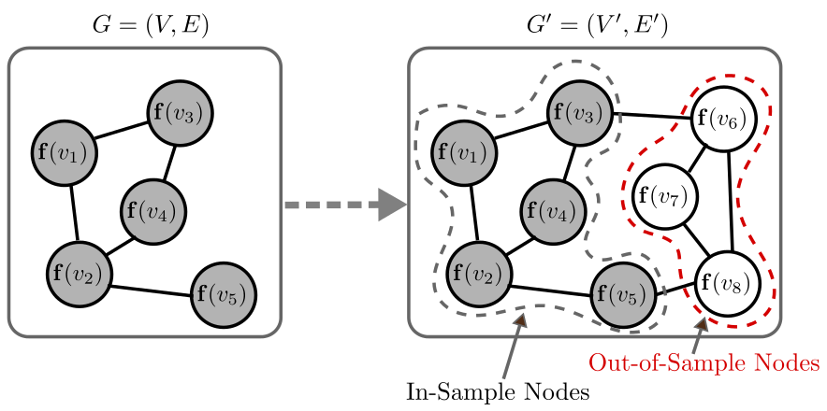
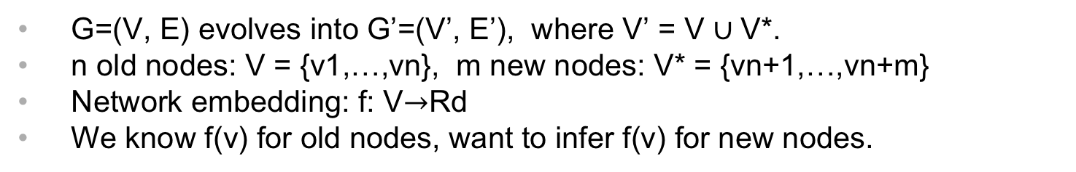
Problem
To infer embeddings for out-of-sample nodes.
G=(V, E) evolves into G’=(V’, E’), where V’ = V $∪$V*.
n old nodes: V = {v1,…,vn}, m new nodes: V* = {vn+1,…,vn+m}
Network embedding: f: V$→$Rd
We know f(v) for old nodes, want to infer f(v) for new nodes.

Slide 55
Challenges
Preserve network structures
e.g. high-order proximity
need to incorporate prior knowledge on networks
Share similar characteristics with in-sample embeddings
e.g. magnitude, mean, variance
requires a model with great expressive power to fit the data well
Low computational cost
Jianxin Ma, et al. DepthLGP: Learning Embeddings of Out-of-Sample Nodes in Dynamic Networks. AAAI, 2018.

Slide 56
Specific vs. General
Specific
A new NE algorithm capable of handling OOS nodes.
General
A solution that helps an arbitrary NE algorithm handle OOS nodes.
We propose a general solution.
But it can be easily integrated into an existing NE algorithm (e.g. DeepWalk) to derive a specific algorithm (see the paper).
Jianxin Ma, et al. DepthLGP: Learning Embeddings of Out-of-Sample Nodes in Dynamic Networks. AAAI, 2018.
Notes:
TODO: What’s the motivation of proposing a general solution. (Don’t know how to fix this anyway.)

Slide 57
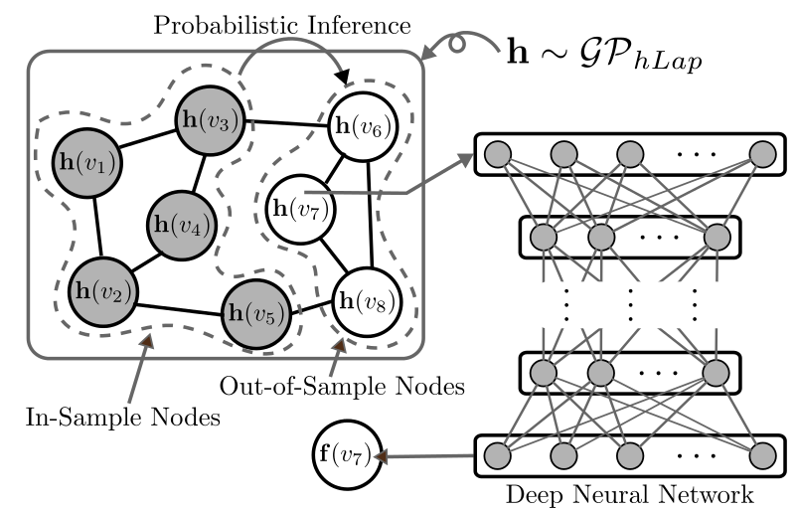
DepthLGP
Nonparametric probabilistic modeling + Deep Learning
Jianxin Ma, et al. DepthLGP: Learning Embeddings of Out-of-Sample Nodes in Dynamic Networks. AAAI, 2018.

Slide 58
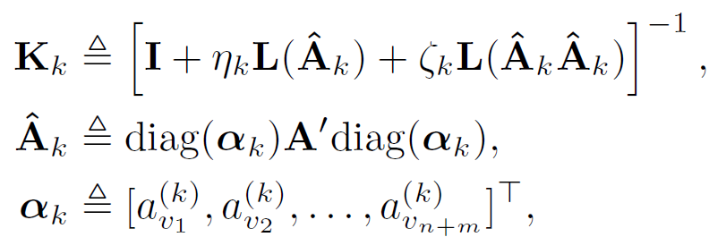
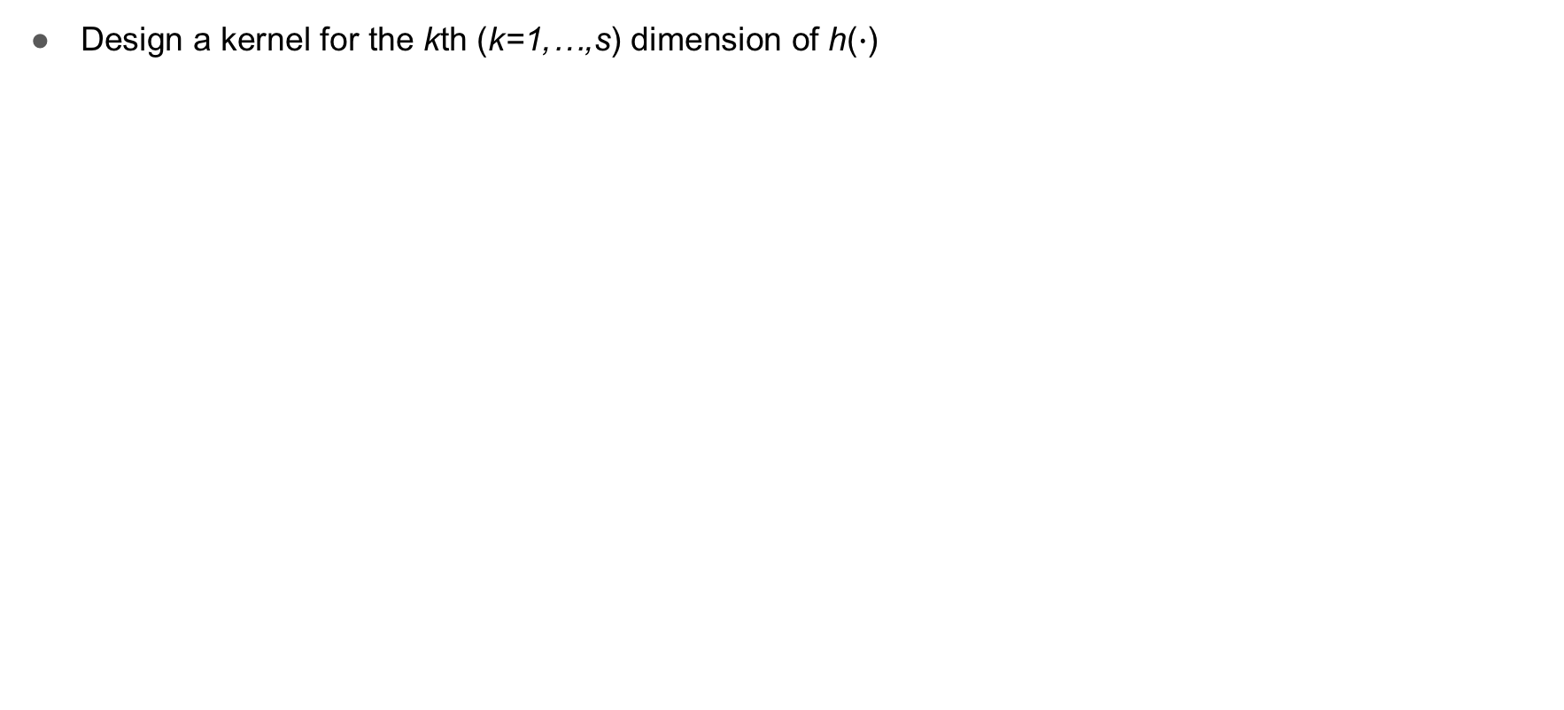
DepthLGP
Design a kernel for the kth (k=1,…,s) dimension of h($∙$)
First-order Proximity
Second-order Proximity
Node Weights
(to prune uninformative nodes)
¹The matrix inversion can be bypassed without approximation.
²a^{(k)}_{v} indicates how much attention we pay to a node. It is learned for an in-sample node, but fixed to one for an OOS node, as we are always interested in OOS nodes.

Slide 59
Key problems in dynamic network embedding
I : Out-of-sample nodes
II : Incremental edges
III: Aggregated error
IV: Scalable optimization

Slide 60
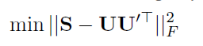
The Static Model
We aim to preserve high-order proximity in the embedding matrix with the following objective function：
where S denotes the high-order proximity matrix of the network
U and U’ is the results of matrix decomposition of S.
For undirected networks, U and U’ are highly correlated.
Without loss of generality, we choose U as the embedding matrix.
Dingyuan Zhu, et al. High-order Proximity Preserved Embedding For Dynamic Networks. IEEE TKDE, 2018.

Slide 61
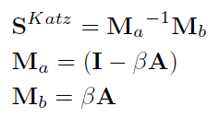
GSVD
We choose Katz Index as S because it is one of the most widely used measures of high-order proximity.
where β is a decay parameter, I is the identity matrix and A is the adjacency matrix
According to HOPE, the original objective function can be solved by the generalized SVD (GSVD) method
Notes:
[1] HOPE, M. Ou, et al. KDD 2016.

Slide 62
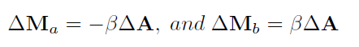
Generalized Eigen Perturbation
We propose generalized eigen perturbation to fulfill the task.
The goal of generalized eigen perturbation is to update X^{(t)} to X^{(t+1)}
Specifically, given the change of adjacency matrix △A between two consecutive time steps, the change of Ma and Mb can be represented as:
Dingyuan Zhu, et al. High-order Proximity Preserved Embedding For Dynamic Networks. IEEE TKDE, 2018.

Slide 63
Key problems in dynamic network embedding
I : Out-of-sample nodes
II : Incremental edges
III: Aggregated error
IV: Scalable optimization

Slide 64







Problem: Error Accumulation
Eigen perturbation is at the cost of inducing approximation
A₀
U₀
$$\underset{⇒}{SVD}$$
∑₀
V₀
$$⇒$$
$$Update$$
A₁
U₁’
$$≈$$
∑₁’
V₁’
Error
Accumulation!
…
$$⇒$$
$$Update$$
A_{t}
U_{t}’
$$≈$$
∑_{t}’
V_{t}’
Problem: error accumulation is inevitable

Slide 65





Solution: SVD Restarts
Solution: restart SVD occasionally
A₀
U₀
$$\underset{⇒}{SVD}$$
∑₀
V₀
$$⇒$$
$$Update$$
A₁
U₁’
∑₁’
V₁’
…
A_{t}
U_{t}
Restart
$$\underset{⇒}{SVD}$$
∑_{t}
V_{t}
$$⇒$$
$$Update$$
When?
A_{t+1}
U_{t+1}’
∑_{t+1}’
V_{t+1}’
What are the appropriate time points?
Too early restarts: waste of computation resources
Too late restarts: serious error accumulation

Slide 66


Naïve Solution
Naïve solution: fixed time interval or fixed number of changes
Difficulty: error accumulation is not uniform
Ziwei Zhang, et al. TIMERS: Error-Bounded SVD Restart on Dynamic Networks. AAAI, 2018.

Slide 67


Existing Method
Existing method: monitor loss (Chen and Candan, KDD 2014)
Loss in SVD:
$𝒥={\left\|S−UΣV^{T}\right\|}_{F}^{2}$
$S$: target matrix, $\left[U,Σ,V\right]:$ results of SVD
Problem: loss includes approximation error and intrinsic loss in SVD
Ziwei Zhang, et al. TIMERS: Error-Bounded SVD Restart on Dynamic Networks. AAAI, 2018.

Slide 68


Framework: Monitor Margin
Observation: the margin between the current loss and intrinsic loss in SVD is the actual accumulated error
Current loss: $𝒥={\left\|S−UΣV^{T}\right\|}_{F}^{2}$
Intrinsic loss: $ℒ\left(S,k\right)=\min_{U^{∗},Σ^{∗},V^{∗}}{{\left\|S−U^{∗}Σ^{∗}{V^{∗}}^{T}\right\|}_{F}^{2}},k:dimensionality$
Ziwei Zhang, et al. TIMERS: Error-Bounded SVD Restart on Dynamic Networks. AAAI, 2018.

Slide 69
Key problems in dynamic network embedding
I : Out-of-sample nodes
II : Incremental edges
III: Aggregated error
IV: Scalable optimization

Slide 70


Highly-dynamic & Recency-sensitive Data
News recommendation applications: a bipartite graph
WeChat news recommendation network is highly dynamic
81 articles and 1400 reading records per second
The network is also recency-sensitive
>73% articles died less than 6 hours while no one read again
Obvious exponential decay for article duration length.
Xumin Chen, et al. Scalable Optimization for Embedding Highly-Dynamic and Recency-Sensitive Data. KDD, 2018.(Applied)

Slide 71
Limited resources
We cannot guarantee convergence in-between every two timestamps.
Just do it.
How to do better?
Non-uniform resource allocation.
New edges and nodes worth more resources.
Xumin Chen, et al. Scalable Optimization for Embedding Highly-Dynamic and Recency-Sensitive Data. KDD, 2018.(Applied)

Slide 72


Diffused SGD: Step-wise Weight Diffusion Mechanism
The Change of a node embedding vector depends on its distance to the changed edge.
Diffuse across training steps
For step $r$, if edge $\left(i,j\right)$ is chosen by stochastic method
Xumin Chen, et al. Scalable Optimization for Embedding Highly-Dynamic and Recency-Sensitive Data. KDD, 2018.(Applied)

Slide 73
Outline
Structure-preserved network embedding
Property-preserved network embedding
Dynamic network embedding
Robustness, Explainability and Applicability
Notes:
分2页，1.0和2.0的区别

Slide 74



Technical challenges in real applications
Research
Application
Robustness
Interpretability
Applicability
Hot directions in computer vision:
Adversarial
Explainable
Scalable
Notes:
分2页，1.0和2.0的区别

Slide 75


Robustness in network embedding
Adversarial attacks
small perturbations in graph structures and node attributes
great challenges for applying GCNs to node classification
Notes:
The pictures represent two different attacking method.

Slide 76
Adversarial Attacks on GCNs
Categories
Targeted vs Non-targeted
Targeted: the attacker focus on misclassifying some target nodes
Non-targeted: the attacker aims to reduce the overall model performance
Direct vs Influence
Direct: the attacker can directly manipulate the edges or features of the target nodes
Influence: the attacker can only manipulate other nodes except the targets
How to enhance the robustness of GCNs against adversarial attacks?
Notes:
Based on different settings, graph adversarial attacks can be divided into following categories
Targeted attacks can be further divided into two categories

Slide 77

Robust Graph Convolutional Networks
Adversarial attacks in node classification
Connect nodes from different communities to confuse the classifier
Distribution V.S. plain vectors
Plain vectors cannot adapt to such changes
Variances can help to absorb the effects of adversarial changes
Gaussian distributions -> Hidden representations of nodes
Notes:
To address this problem, we propose Robust GCN (RGCN), a novel model that “fortifies” GCNs against adversarial attacks.
Specifically, instead of representing nodes as vectors, our method adopts Gaussian distributions as the hidden representations of nodes in each convolutional layer.

Slide 78

Interpretability of network embedding
A real-world graph is typically formed due to many latent factors.
Existing GNNs/GCNs:
A holistic approach, that takes in the whole neighborhood to produce a single node representation.
We suggest:
To disentangle the latent factors. (By segmenting the heterogeneous parts, and learning multiple factor-specific representations for a node.)
Robustness (e.g., not overreact to an irrelevant factor) & Interpretability.
Example
Social Circles
Different Factors
Notes:
Despite their enormous success, the existing graph neural networks generally take a holistic approach to representation learning: the representation learned for a node describes the node’s neighborhood as a perceptual whole, and the nuances between the different parts of the neighborhood are ignored. Yet the formation of a real-world graph typically follows a complex and heterogeneous process, driven by the interac- tion of many latent factors. For example, a person in a social network usually connects with others for various reasons (e.g., work, school), and therefore possesses a neighborhood consisting of several different components. The existing holistic approaches fail to recognize and disentangle the het- erogeneous factors. As a result, the representations learned by them could be non-robust (e.g., prone to overreact to an irrelevant factor) and hardly explainable.

Slide 79


Results: Correlations between the Neurons

Slide 80
Applicability of network embedding
Link Prediction
Community Detection
Node Classification
Network Distance
Node Importance
…
High-order
B
3
1
7
5
8
2
A
C
4
6
Transitivity
Global position
Various network properties
Various applications
Leading to a large number of hyperparameters
Must be carefully tuned
AutoML

Slide 81


AutoML
Ease the adoption of machine learning and reduce the reliance on human experts
e.g., hyperparameter optimization
Largely unexplored on network data
Large scale issue:
Complexity of Network Embedding is usually at least $O\left(E\right)$
E is the number of edges (can be 10 billion)
Total complexity: $O\left(EL\right)$, T is the times searching for optimal hyperparameter
How to incorporate AutoML into massive network embedding efficiently? (reduce E and T)
Notes:
it is unrealistic to automatically search for the optimal configuration by executing the target NE algorithm on such a massive network for a large number of times

Slide 82





AutoML for network embedding
A straightforward way: configuration selection on sampled sub-networks
Transferability
$θ≠$ optimal configuration on origin network
Heterogeneity
several highly heterogeneous components => carefully designed sampling
Sampled sub-network
Optimal configuration $θ$
Origin massive network
Ke Tu, Jianxin Ma, Peng Cui, Jian Pei, Wenwu Zhu. AutoNRL: Hyperparameter Optimization for Massive Network Representation Learning. KDD, 2019.

Slide 83

AutoNE
Transfer the knowledge about optimal hyperparameters from the sub-networks to the original massive network
Ke Tu, Jianxin Ma, Peng Cui, Jian Pei, Wenwu Zhu. AutoNRL: Hyperparameter Optimization for Massive Network Representation Learning. KDD, 2019.
Notes:
To address the above challenges, we propose a novel framework, named AutoNE, for automatically deciding the optimal hyperparameter configuration of a NE algorithm. Our framework consists of three major modules: the sampling module, the signature extraction module, and the meta-learning module.

Slide 84
Cognitive
Graph
Motivations
Graph Neural Networks
15 mins
30 mins
AM
30 mins
30 mins
30 mins
30 mins
Network Embedding
Practical Applications

Slide 85





Connecting NE with graph neural networks
Random Walk
Skip Gram
Input:
Adjacency Matrix
$$A$$
Output:
Vectors
$$Z$$
$$S=f(A)$$
Matrix Factorization
(sparse) Matrix Factorization
$$Z=f(Z′)$$
$$h=f(Ah′)$$

Slide 86




Graph Neural Networks
GINs, Graph Infomax
2019: Keyulu et al., ICLR’ 19, Velickovic et al., ICLR’19
FastGCNs, Graph attention
2018: Velickovic et al., ICLR’18, Chen et al., ICLR 2018
Neural message passing, GraphSage
2017: Gilmer et al., ICML’17; Hamilton et al., NIPS’17
Gated graph neural network
2016: Li et al., ICLR’16
structure2vec
2016: Dai et al., ICML’16
Graph convolutional network
2015: Duvenaud et al., NIPS’15; Kipf & Welling ICLR’17
Spectral graph convolution
2014: Bruna et al., ICLR’14
Graph neural network
2005: Gori et al., IJCNN’05

Slide 87
What are the fundamentals
underlying random-walk + skip-gram based network embedding models?

Slide 88







Unifying DeepWalk, LINE, PTE, & node2vec as Matrix Factorization
DeepWalk
The most cited paper in KDD14
LINE
The most cited paper in WWW15
PTE
The 5th most cited paper in KDD15
node2vec
The 2nd most cited paper in KDD16
$$A$$
Adjacency matrix
b: #negative samples
T: context window size
$$D$$
Degree matrix
$$vol\left(G\right)=\sum_{i}{\sum_{j}{A_{ij}}}$$
Qiu et al. Network embedding as matrix factorization: unifying deepwalk, line, pte, and node2vec. In WSDM’18. The most cited paper in WSDM’18 as of May 2019

Slide 89

Connecting NE with Graph Neural Networks
Random Walk
Skip Gram
Input:
Adjacency Matrix
$$A$$
Output:
Vectors
$$Z$$
$$S=f(A)$$
Matrix Factorization
$$f\left(A\right) =$$

Slide 90


Challenges
$$S=$$
dense
NetMF is not practical for very large networks

Slide 91

NetMF
How can we solve this issue?
Construction
Factorization
$$S=$$
Qiu et al. NetSMF: Network embedding as sparse matrix factorization. In WWW 2019

Slide 92
NetSMF--Sparse
How can we solve this issue?
Sparse Construction
Sparse Factorization
$$S=$$
Qiu et al. NetSMF: Network embedding as sparse matrix factorization. In WWW 2019

Slide 93
Connecting NE with graph neural networks
Random Walk
Skip Gram
Input:
Adjacency Matrix
$$A$$
Output:
Vectors
$$Z$$
$$S=f(A)$$
Matrix Factorization
(sparse) Matrix Factorization
$$Z=f(Z′)$$
$$h=f(Ah′)$$

Slide 94
GCN
GCNs can be considered as a simplification of the traditional graph spectral methods
The common strategy is to model a node’s neighborhood as the receptive field and then apply the graph convolution operation

Slide 95

Graph neural networks
Input: an undirected weighted network $G=(V, E)$ with $\left|V\right|=n$ & $\left|E\right|=m$
Adjacency matrix $A∈ℝ_{+}^{n×n}$
$A_{i,j }= \left\{\begin{aligned}a_{i,j}>0 \left(i, j\right)∈E \\ 0 \left(i,j\right)∉E\end{aligned}\right.$
Degree matrix $D=diag(d_{1}, d_{2},⋯, d_{n})$
Node feature matrix $X∈ℝ^{n×q}$
Output: for each node, its $k$-dimension latent feature representation vector $Z^{n×k}$
Latent feature embedding matrix ${Z∈ℝ}^{n×k}$

Slide 96

The core of graph neural networks
a
b
$$h_{v}=f(h_{a}, h_{b}, h_{c}, h_{d}, h_{e})$$
v
c
e
d
Neighborhood Aggregation:
Aggregate neighbor information and pass into a neural network

Slide 97

Convolutional neural network
$$∑WX$$

Slide 98
Convolutional neural network
$$∑WX$$

Slide 99
Convolutional neural network
$$∑WX$$

Slide 100
Convolutional neural network
$$∑WX$$

Slide 101
Convolutional neural network
$$∑WX$$

Slide 102

Graph neural networks
a
b
$$h_{a}=f(h_{a}, h_{b}, h_{c}, h_{d}, h_{e})$$
v
c
e
d
Neighborhood Aggregation:
Aggregate neighbor information and pass into a neural network
It can be viewed as a center-surround filter in CNN---graph convolutions!

Slide 103

GNN: Graph convolutional networks
a
b
$$h_{v}^{k}=σ(W^{k}\sum_{u∈N\left(v\right)∪v}{\frac{h_{u}^{k−1}}{\sqrt{|N(u)||N(v)|}}})$$
v
c
e
d
Kipf et al. Semisupervised Classification with Graph Convolutional Networks. ICLR 2017

Slide 104



GNN: Graph convolutional networks
parameters in layer $k$
a
b
Non-linear activation function (e.g., ReLU)
$$h_{v}^{k}=σ(W^{k}\sum_{u∈N\left(v\right)∪v}{\frac{h_{u}^{k−1}}{\sqrt{|N(u)||N(v)|}}})$$
v
c
e
node $v$’s embedding at layer $k$
d
the neighbors of node $v$

Slide 105
GNN: Graph convolutional networks
a
b
$$h_{v}^{k}=σ(W^{k}\sum_{u∈N\left(v\right)∪v}{\frac{h_{u}^{k−1}}{\sqrt{|N(u)||N(v)|}}})$$
v
c
e
d
Kipf et al. Semisupervised Classification with Graph Convolutional Networks. ICLR 2017

Slide 106


GNN: Graph convolutional networks
Aggregate from $v$’s neighbors
a
b
$$h_{v}^{k}=σ(W^{k}\sum_{u∈N\left(v\right)}{\frac{h_{u}^{k−1}}{\sqrt{\left|N\left(u\right)\right|\left|N\left(v\right)\right|}}}+$$
$${ W}^{k}\sum_{v}{ \frac{h_{v}^{k−1}}{\sqrt{|N(v)||N(v)|}}})$$
v
c
e
d
Aggregate from itself
Kipf et al. Semisupervised Classification with Graph Convolutional Networks. ICLR 2017

Slide 107

GNN: Graph convolutional networks
The same parameters for both its neighbors & itself
a
b
$$h_{v}^{k}=σ(W^{k}\sum_{u∈N\left(v\right)}{\frac{h_{u}^{k−1}}{\sqrt{\left|N\left(u\right)\right|\left|N\left(v\right)\right|}}}+$$
$${ W}^{k}\sum_{v}{ \frac{h_{v}^{k−1}}{\sqrt{|N(v)||N(v)|}}})$$
v
c
e
d
Kipf et al. Semisupervised Classification with Graph Convolutional Networks. ICLR 2017

Slide 108



GNN: Graph convolutional networks
$$D^{−\frac{1}{2}}AD^{−\frac{1}{2}}H^{\left(k−1\right)}W^{\left(k\right)}$$
a
b
$$h_{v}^{k}=σ(W^{k}\sum_{u∈N\left(v\right)}{\frac{h_{u}^{k−1}}{\sqrt{\left|N\left(u\right)\right|\left|N\left(v\right)\right|}}}+$$
$${ W}^{k}\sum_{v}{ \frac{h_{v}^{k−1}}{\sqrt{|N(v)||N(v)|}}})$$
v
c
e
d
$$D^{−\frac{1}{2}}ID^{−\frac{1}{2}}H^{\left(k−1\right)}W^{\left(k\right)}$$
Kipf et al. Semisupervised Classification with Graph Convolutional Networks. ICLR 2017

Slide 109





GNN: Graph convolutional networks
$$H^{k}=σ\left(D^{−\frac{1}{2}}\left(A+I\right)D^{−\frac{1}{2}}H^{\left(k−1\right)}W^{\left(k\right)}\right)$$
$Z$ =$H^{K}$
$$G=(V, E, A)$$
$$H^{0}= X$$
Input
Output

Slide 110





GNN: Graph convolutional networks
$$H^{k}=σ\left(D^{−\frac{1}{2}}\left(A+I\right)D^{−\frac{1}{2}}H^{\left(k−1\right)}W^{\left(k\right)}\right)$$
$Z$ =$H^{K}$
$$G=(V, E, A)$$
$$H^{0}= X$$
Input
Model training
The common setting is to have an end to end training framework with a supervised task
That is, define a loss function over $Z$
Output

Slide 111
GNN: Graph convolutional networks
$$H^{k}=σ\left(D^{−\frac{1}{2}}\left(A+I\right)D^{−\frac{1}{2}}H^{\left(k−1\right)}W^{\left(k\right)}\right)$$
$Z$ =$H^{K}$
$$G=(V, E, A)$$
$$H^{0}= X$$
Input
Benefits: Parameter sharing for all nodes
#parameters is subline in |V|
Enable inductive learning for new nodes
Output

Slide 112

GNN: Graph convolutional networks
$$H^{k}=σ\left(D^{−\frac{1}{2}}\left(A+I\right)D^{−\frac{1}{2}}H^{\left(k−1\right)}W^{\left(k\right)}\right)$$
GCN is one way of neighbor aggregations
GraphSage
Graph Attention
… …

Slide 113

GraphSage
GCN
$$h_{v}^{k}=σ(W^{k}\sum_{u∈N\left(v\right)∪v}{\frac{h_{u}^{k−1}}{\sqrt{|N(u)||N(v)|}}})$$
a
b
v
c
e
GraphSage
d
$$h_{v}^{k}=σ([A^{k}⋅AGG\left(\left\{h_{u}^{k−1}, ∀u∈N\left(v\right)\right\}\right),B^{k}h_{v}^{k−1}])$$
Generalized aggregation: any differentiable function that maps set of vectors to a single vector
Hamilton et al. Inductive Representation Learning on Large Graphs. NIPS 2017
Hamiltion & Tang, AAAI 2019 Tutorial on Graph Representation Learning

Slide 114
GraphSage
GCN
$$h_{v}^{k}=σ(W^{k}\sum_{u∈N\left(v\right)∪v}{\frac{h_{u}^{k−1}}{\sqrt{|N(u)||N(v)|}}})$$
a
b
v
c
e
GraphSage
Instead of summation, it concatenates neighbor & self embeddings
d
$$h_{v}^{k}=σ([A^{k}⋅AGG\left(\left\{h_{u}^{k−1}, ∀u∈N\left(v\right)\right\}\right),B^{k}h_{v}^{k−1}])$$
Generalized aggregation: any differentiable function that maps set of vectors to a single vector
Hamilton et al. Inductive Representation Learning on Large Graphs. NIPS 2017
Hamiltion & Tang, AAAI 2019 Tutorial on Graph Representation Learning

Slide 115

GraphSage
$$h_{v}^{k}=σ([A^{k}⋅AGG\left(\left\{h_{u}^{k−1}, ∀u∈N\left(v\right)\right\}\right),B^{k}h_{v}^{k−1}])$$
Hamilton et al. Inductive Representation Learning on Large Graphs. NIPS 2017
Slide snipping from “Hamiltion & Tang, AAAI 2019 Tutorial on Graph Representation Learning”

Slide 116
Graph Neural Networks
a
b
v
Realistically, neighbors are of different importance to each node
c
e
d
Velickovic et al. Graph Attention Networks. ICLR 2018

Slide 117
Graph Neural Networks
$$H^{k}=σ\left(D^{−\frac{1}{2}}\left(A+I\right)D^{−\frac{1}{2}}H^{\left(k−1\right)}W^{\left(k\right)}\right)$$
GCN is one way of neighbor aggregations
GraphSage
Graph Attention
… …

Slide 118

GNN: Graph Attention
GCN
$$h_{v}^{k}=σ(W^{k}\sum_{u∈N\left(v\right)∪v}{\frac{h_{u}^{k−1}}{\sqrt{|N(u)||N(v)|}}})$$
a
b
v
c
e
Graph Attention
d
$$h_{v}^{k}=σ(\sum_{u∈N\left(v\right)∪v}{α_{v,u}W^{k}h_{u}^{k−1}})$$
Learned attention weights
Velickovic et al. Graph Attention Networks. ICLR 2018

Slide 119

GNN: Graph Attention
a
b
v
c
e
d
Various ways to define attention!
Velickovic et al. Graph Attention Networks. ICLR 2018

Slide 120
Graph Neural Networks
Cognitive
Graph
Motivations
15 mins
30 mins
30 mins
30 mins
30 mins
45 mins
30 mins
Network Embedding
Practical
Applications

Slide 121


A GE Oriented Recommendation System in Practice
Sampling: Representative and Negative Samples
Multiplex:
Node and Edge Heterogeneities
Mixture Modes:
Users with Different Latent Interest Categories
Hierarchical:
Users’ community structures and items’ categories
Extremely Large Scale Attributed Heterogeneous Graphs with Billions of Nodes and Trillions of Edges
Unified Graph Embeddings for Both Various Topological and Attributed Spaces
Practical Challenges and Our Current Focuses

Slide 122

GNN Framework Overview

Slide 123


System Optimizations
Embedding h
Graph partitioning and clustering
Co-locate embedding variables with graph partitions
Reuse embedding if possible

Slide 124









GNN Platform Overview
AliGraph: A Comprehensive Graph Neural Network Platform. 45th International Conference on Very Large Data Bases (VLDB), 2019.
RAW DATA
PROCESS
DISPATCH & LOAD
TRAINING
INFERENCE
OUTPUTS
FEEDBACK
Node
prediction
Edge
prediction
Community detection
Pattern
Recognition
Dynamic graph
PARALLEL LEARNING AND INFERNCE
EXTREMELY LARGE SCALE GRAPHS
1. Rich algorithm warehouse with improved accuracy measures (5%-90%) for practical
challenges;
2. Performs an order of magnitude faster in terms of graph building, e.g., 492.90 million
vertices, 6.82 billion edges and rich attributes, 2 minutes vs hours by other state-of-
the-arts;
3. 40%-50% faster with the novel caching strategy and demonstrates around 12 times
speed up with the improved runtime.
PS
PS
Extremely
Large
Scale
Graph
Represent-ation
Platform
PS
Billions of nodes, trillions of edges
PARAMETERS
GRADIENTS
Load
WORKER
WORKER
Built in
Algo
Store
Apply
Data Sources
Graphs
Sample
Aggregate
Merge
WORKER
TensorFlow
MPI
Heterogeneous Graph
Computing
CPU
GPU

Slide 125

Various GE/GNN Methods

Slide 126

Multiplex
Representation Learning for Attributed Multiplex Heterogeneous Network, KDD 2019

Slide 127



Transductive Model:
Inductive Model:

Slide 128


Slide 129


Mixture GNN
Is a Single Vector Enough? Exploring Node Polysemy for Network Embedding, KDD 2019

Slide 130

Hierarchical GNN
Hierarchical Representation Learning for Bipartite Graphs, IJCAI 2019

Slide 131

Evolving GNN
Large Scale Evolving Graphs with Burst Detection, IJCAI 2019

Slide 132

Bayesian GNN
Refining Representation by Integrating Knowledge Graphs and Behavior-specific Networks, CIKM 2019
BEM is proposed to bridge KG and BG seamlessly, with the consideration of the behavior-specific bias. This framework provides a new perspective of making a reasoning mechanism (cognitive graph).
As a method, BEM is generic and flexible in that it can use any KG embeddings to correct any BG embeddings. On the contrary, it is potentially able to help KG embeddings acquire novel knowledge from the BG embeddings that does not exist in the knowledge graph.

Slide 133
Selected Publications
1. Representation Learning for Attributed Multiplex Heterogeneous Network. 25th ACM SIGKDD Conference on Knowledge Discovery and Data Mining (KDD), 2019.
2. Is a Single Vector Enough? Exploring Node Polysemy for Network Embedding. 25th ACM SIGKDD Conference on Knowledge Discovery and Data Mining (KDD), 2019.
3. Towards Knowledge-Based Personalized Product Description Generation in E-commerce. 25th ACM SIGKDD Conference on Knowledge Discovery and Data Mining (KDD), 2019.
4. Sequential Scenario-Specific Meta Learner for Online Recommendation. 25th ACM SIGKDD Conference on Knowledge Discovery and Data Mining (KDD), 2019.
5. AliGraph: A Comprehensive Graph Neural Network Platform. 45th International Conference on Very Large Data Bases (VLDB), 2019.
6. Large Scale Evolving Graphs with Burst Detection. 28th International Joint Conference on Artificial Intelligence (IJCAI), 2019.
7. Hierarchical Representation Learning for Bipartite Graphs. 28th International Joint Conference on Artificial Intelligence (IJCAI), 2019.
8. Cognitive Graph for Multi-Hop Reading Comprehension at Scale. 57th Annual Meeting of the Association for Computational Linguistics (ACL), 2019.
9. Subgraph-augmented Path Embedding for Semantic User Search on Heterogeneous Social Network, WWW, 2018.
10. ANRL: Attributed Network Representation Learning via Deep Neural Networks, IJCAI, 2018.
11. Adversarial Detection with Model Interpretation. KDD, 2018.
12. SPARC: Self-Paced Network Representation for Few-Shot Rare Category Characterization. KDD, 2018.
13. Mobile access record resolution on large-scale identifier-linkage graphs. KDD, 2018.
14. Interactive Paths Embedding for Semantic Proximity Search on Heterogeneous Graphs. KDD, 2018.
15. PRRE: Personalized Relation Ranking Embedding for Attributed Network. 27th ACM International Conference on Information and Knowledge Management (CIKM), 2018.
17. Heterogeneous Embedding Propagation for Large-scale E-Commerce User Alignment, 2018 IEEE International Conference on Data Mining (ICDM), 2018
18. Local Algorithm for User Action Prediction Towards Display Ads. 23rd ACM SIGKDD Conference on Knowledge Discovery and Data Mining (KDD), 2017.
19. Hybrid Framework for Text Modeling with Convolutional RNN. 23rd ACM SIGKDD Conference on Knowledge Discovery and Data Mining (KDD), 2017.
20. Bayesian Heteroscedastic Matrix Factorization for Conversion Rate Prediction. 26th ACM International Conference on Information and Knowledge Management (CIKM), 2017.
21. Will Triadic Closure Strengthen Ties in Social Networks?, ACM Transactions on Knowledge Discovery from Data (TKDD), 2017.

Slide 134
Graph Neural Networks
Cognitive
Graph
Motivations
15 mins
30 mins
30 mins
30 mins
30 mins
30 mins
45 mins
30 mins
Network Embedding
Practical Applications

Slide 135
Cognitive Recommendation
What is recommendation based on cognitive reasoning?
Moisturizing vs Girls born after 90s need moisturizing if staying up late
Why cognitive reasoning?
Supermarket (Initial) -> Personalized Shelf (Thousand People Thousand Faces) -> Personalized Shelf with AI Shopping Guide (Cognitive Reasoning)
Recommendation based on
Cognitive Reasoning
Knowledge Graph
+
Common Sense
Content Display
Content
Commercialization
GNN As Reasoning Engine
Fashion Icon Articles to connect KG and common sense
Generate recommended reasons and recall related videos
Video and Articles product detection

Slide 136








DEMO

Slide 137




Cognitive GNN
Towards Knowledge-Based Personalized Product Description
Generation in E-commerce, KDD 2019

Slide 138

Cognitive GNN
Cognitive Graph for Multi-Hop Reading Comprehension at Scale, ACL 2019

Slide 139
Causality/GNN/Disentanglement
Causality
Causal Graph Inference Engine
Anti Causal Learning
A Formal Definition
GNN
Disentangle
Disentangled RepLearn on Graphs

Slide 140

Causality vs Disentanglement
Representation learning (RepLearn):
To infer $Z$ that explains $X$, usually via a generative model $P\left(X∣Z\right)$.
Causal discovery:
To infer the causal mechanism $P\left(X∣do\left(Z\right)\right)$, when given $Z$ and $X$.
Disentangled RepLearn[Definition from Suter et al., 2019]:
To infer (1) $Z$ that causes $X$, and (2) the causal mechanism $P\left(X∣do\left(Z\right)\right)$.
Moreover, (3) $Z$ should contain independent, direct causes of $X$.
RepLearn
Causal Discovery
Generative RepLearn
Disentangled RepLearn
Robustly Disentangled Causal Mechanisms. Suter et al., ICML 2019.

Slide 141





Causality vs RepLearn
Anti-causal learning: To infer the cause given the effect.
E.g., to predict a user’s preference (cause) given his/her behavior (effect).
E.g., to predict lung cancer (cause) given a lung image (effect).
$$X$$
$$f\left(Z\right)=X$$
$$Z$$
$$Z$$
On Causal and Anticausal Learning. Schölkopf et al., ICML 2012.
Generalization in anti-causal learning. Kilbertus et al., arXiv 1812.00524.

Slide 142


Causality vs RepLearn
All these representations can achieve the maximum likelihood.
Disentangled representation I: $P_{θ_{A}}(A)$ and $P_{θ_{B∣A}}(B∣A)$ .
Disentangled representation II: $P_{θ_{B}}(B)$ and $P_{θ_{A∣B}}(A∣B)$ .
But if $A→B$ is true, then $P_{θ_{A}}\left(A\right)⋅P_{θ_{B∣A}}(B∣A)$ needs much fewer new samples to adapt to the new distribution once $P(A,B)$ shifts.
Because we need to update only $θ_{B|A}$.
It adapts faster if correctly disentangled.
This is a new approach to infer the causal direction!

